Slide 1

Project name : eArtShop (Online shopping for Artworks)
Emmanuel Cadet
Aklilu G.
Bisrat Kidane
Romuald Pogo K.
Team members:

Slide 2
Problem scenario description
Everybody passionate of art face the following difficulties :
Travel long distance to the art gallery and auction room
Wait for opening hours, and events
Artists to expose their works :
Have a hard time to expose their works
Notes:
Mr. Sahl has been running the art gallery business for so many years in a traditional manual way. The current manual system involves people from deferent walks of the world making long distance travels just to be present at an auction room. This is to attend and to see some of the artworks being show cased and choose one which is interesting. The limitation of this is the travelling and wasting of money just to come and buy one artwork.
The introduction of online art gallery system will be a way of solving most of the problems. It will be used by artists who are interested in selling their art works effectively. It will also be used by the gallery owner to increase the number of customers in significant amount.
Customer can browse through the artwork category and view and add the items to shopping cart. He/She can proceed to checkout as long as the shopping is not empty. Customer will be required to login to the system when he/she proceed to checkout or create an account if doesn’t have one. The order will be charged to any type of payment method registered in customer’s Account. Finally, the purchased artwork will be shipped to the provide customer’s shipping address.
The customer has an option to return the purchased artwork within 30 days if the purchased artwork is in the same condition when purchased as well as if it is returnable.
The customer has also an option to cancel an order.
On the other hand the gallery owner manages the artwork by adding or removing some artworks and change Order’s status.

Slide 3
Software Requirement Specification (SRS)
1. Requirement Analysis

Slide 4


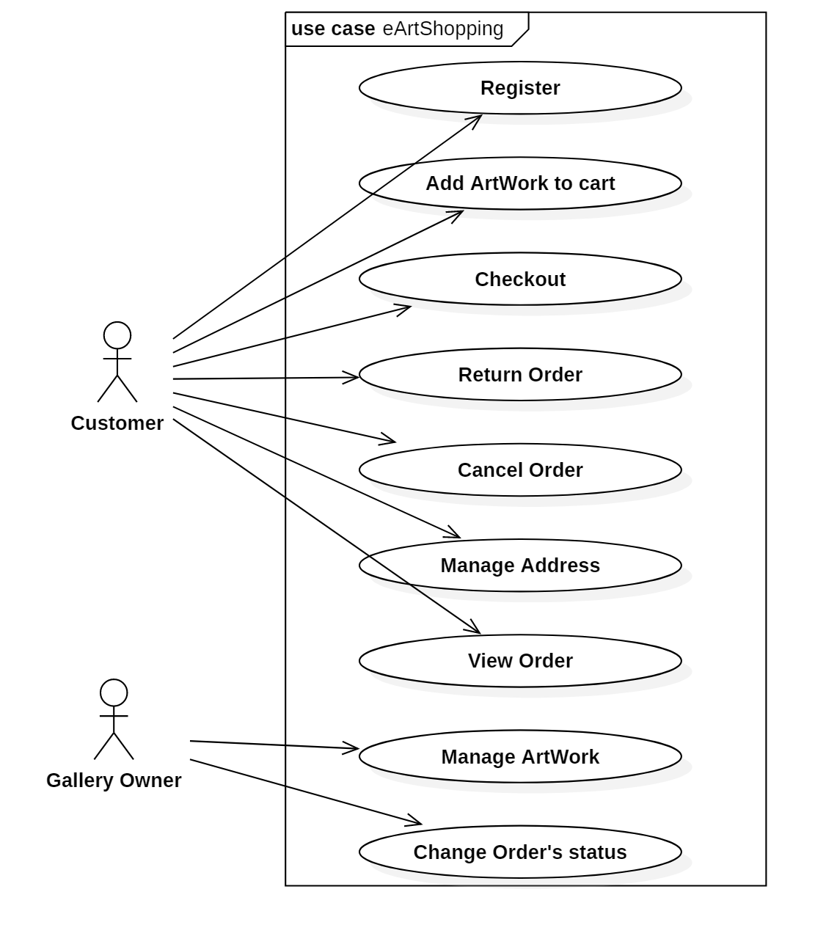

Use case Diagram
z

Slide 5
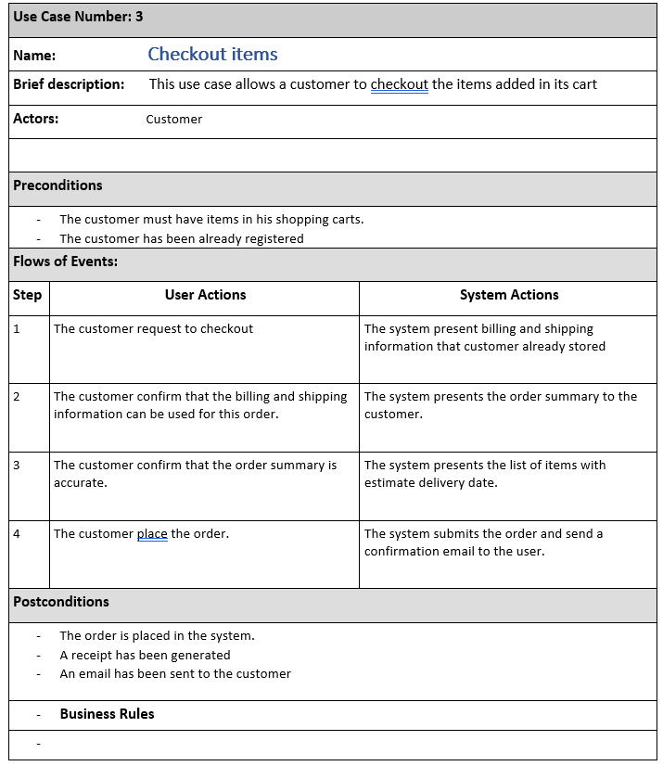
Use-Case Description

Slide 6
2. Architectural Analysis

Slide 7
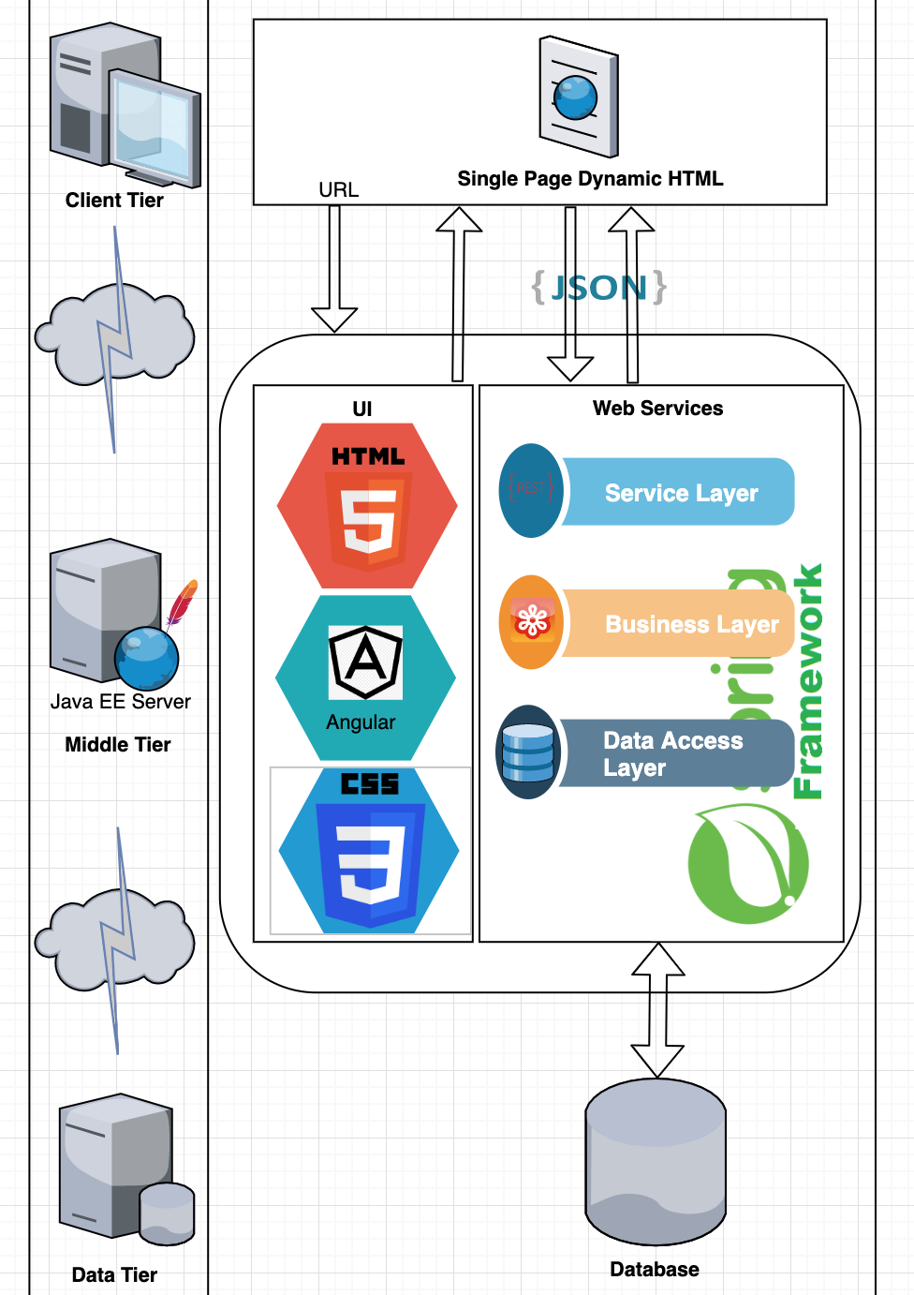
Single Page Application (SPA)

Slide 8
Key abstractions
Artwork
Customer
Order
CheckoutRecord
ShoppingCart
Category
ShippingAddress
PaymentMethod

Slide 9
3. Use-Case Analysis

Slide 10
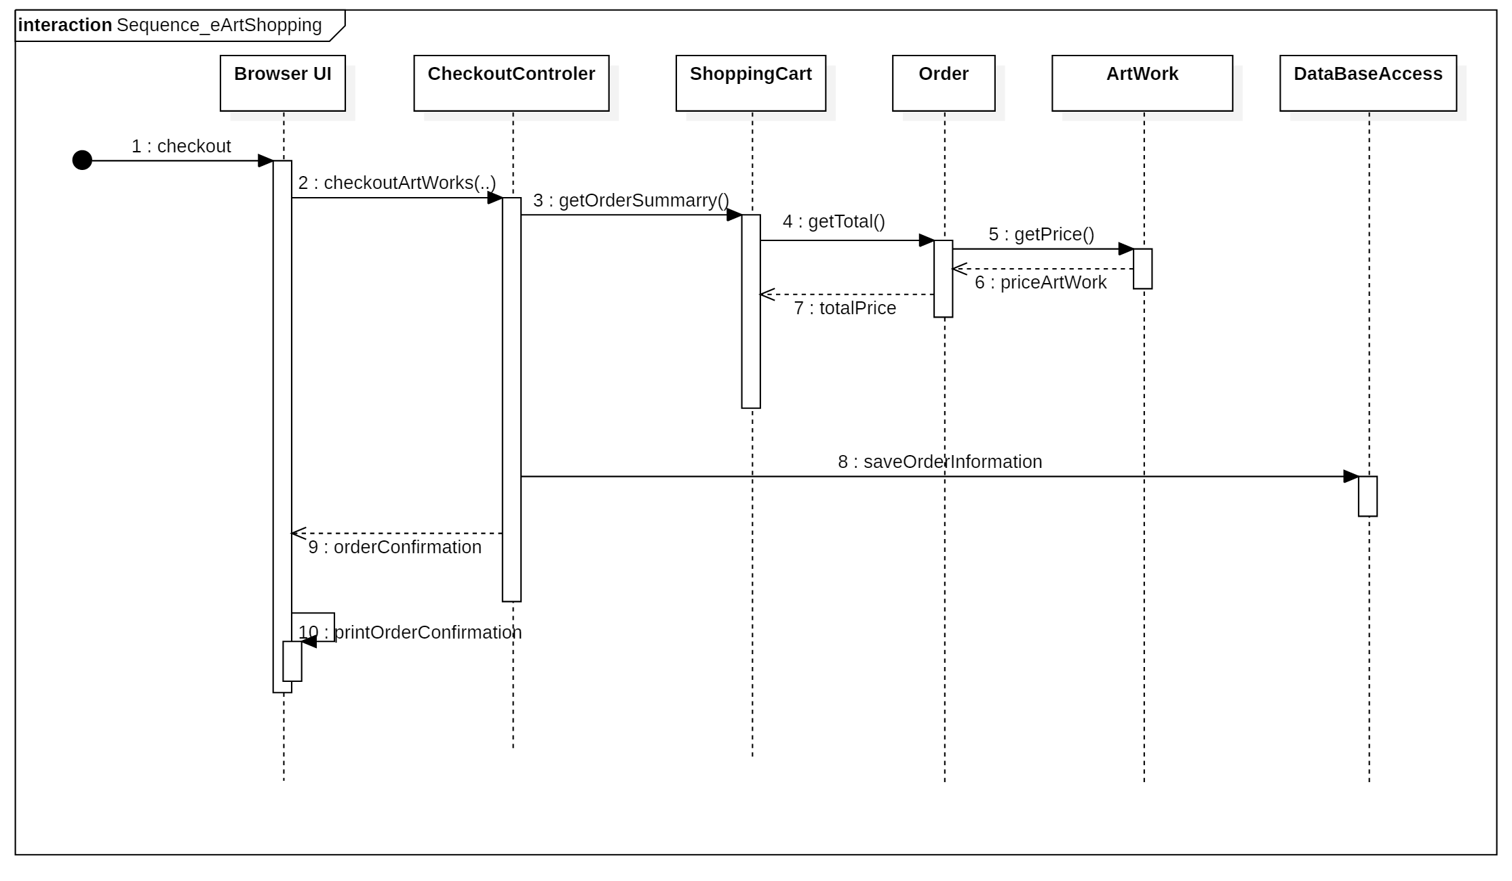
Sequence Diagram For Your Main Use-case

Slide 11
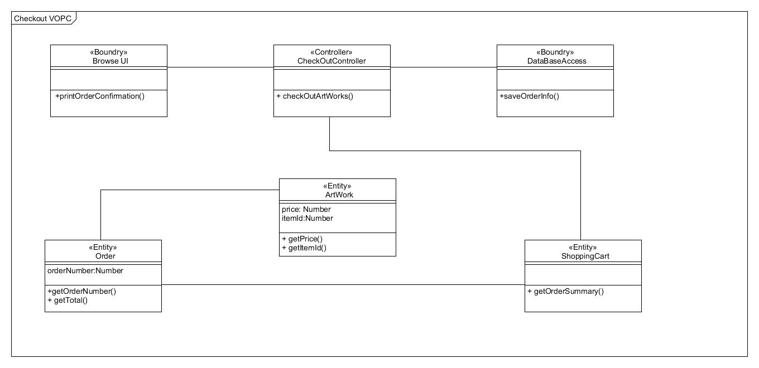
View Of Participating Classes

Slide 12
Conclusion
New Online Solution :
A customer will be able to :
browse through a whole catalogue of art work 24/7
manage a shopping cart of artworks
checkout a selection of art works
An artist will be able to :
Expose to the whole world his artworks
Have wider range of customer
Notes:
Customer can browse through the artwork category and view and add the items to shopping cart. He/She can proceed to checkout as long as the shopping is not empty. Customer will be required to login to the system when he/she proceed to checkout or create an account if doesn’t have one. The order will be charged to any type of payment method registered in customer’s Account. Finally, the purchased artwork will be shipped to the provide customer’s shipping address.
The customer has an option to return the purchased artwork within 30 days if the purchased artwork is in the same condition when purchased as well as if it is returnable.
The customer has also an option to cancel an order.

Slide 13


Questions
z

